Slide 1

Exploratory Data Analysis
Housing prices in Buenos Aires
21/03/2022

Slide 2

Agenda
Executive Summary
Problem Statement
Approach
EDA
EDA Summary
Recommendations

Slide 3
Executive Summary
Exploratory Data Analysis is a process that helps analysts to make sense of their data by looking for patterns, anomalies, and outliers. This helps in better understanding of the data before any modelling begins.
The dataset used in the EDA process is Buenos Aires-Sheet1 which contains 16 variables and 8606 observations.
The variables included, operations, property type, latitude and longitude, price of the properties in local and foreign currency, the surface are covered by the property etc.
We seek to analyze the factors affecting price of properties in Buenos Aires.

Slide 4
Problem Statement
We seek to investigate;
Is there a relationship between size of a property and property price?
Is there a relationship between neighborhoods and property price?
Is there a relationship between location and price?
What factors are important in determining the price of a property?

Slide 5
Approach
The approach in analyzing this data included;
Cleaning the data.
Perform exploratory data analysis (EDA).
Feature selection.
Build the model.
Test models.

Slide 6
Data Cleaning and EDA
The EDA processes done in this dataset include;
The first thing I did was to check each data type of columns and check for missing values. I then dropped the ‘expense’ and ‘floor’ columns because they each had 89% and 85% missing data respectively.
I then split the ‘place_with_parent_names’ column to create the neighborhood and state column. I also split the ‘lat-lon’ column and created the lat and lon columns to represent latitude and longitude respectively and changed their data types to float. I then dropped the ‘place_with_parent_names’ and ‘lat-lon’ columns.
I dropped three columns ‘operation’ and ’currency’, for having low cardinality and also dropped 'properati_url‘ column fro having a very high cardinality and wouldn’t be useful in the analysis of the data.

Slide 7
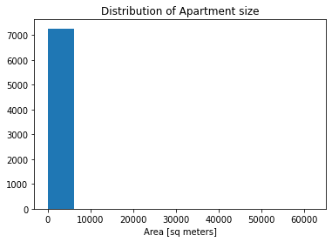
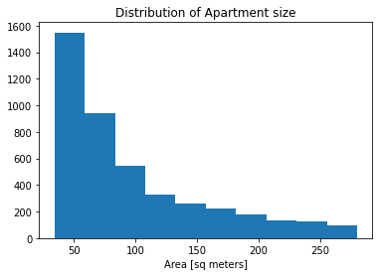
Continuation of EDA
After plotting the histogram of the surface area covered, it could be observed that there was outliers present in the dataset. The outliers present below the 0.1 quantile and above the 0.9 quantile were removed.
With Outliers Without outliers

Slide 8
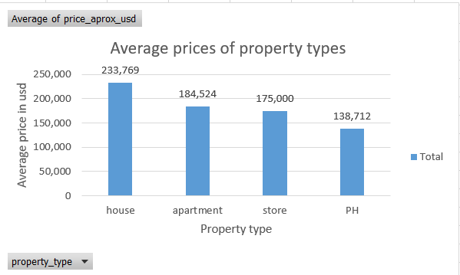
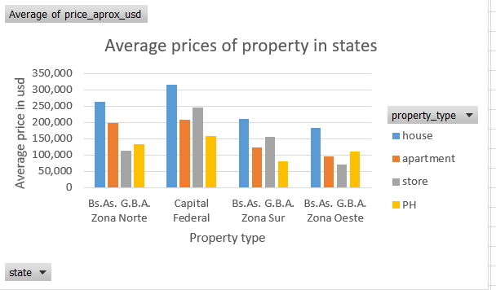
Mean Average prices

Slide 9
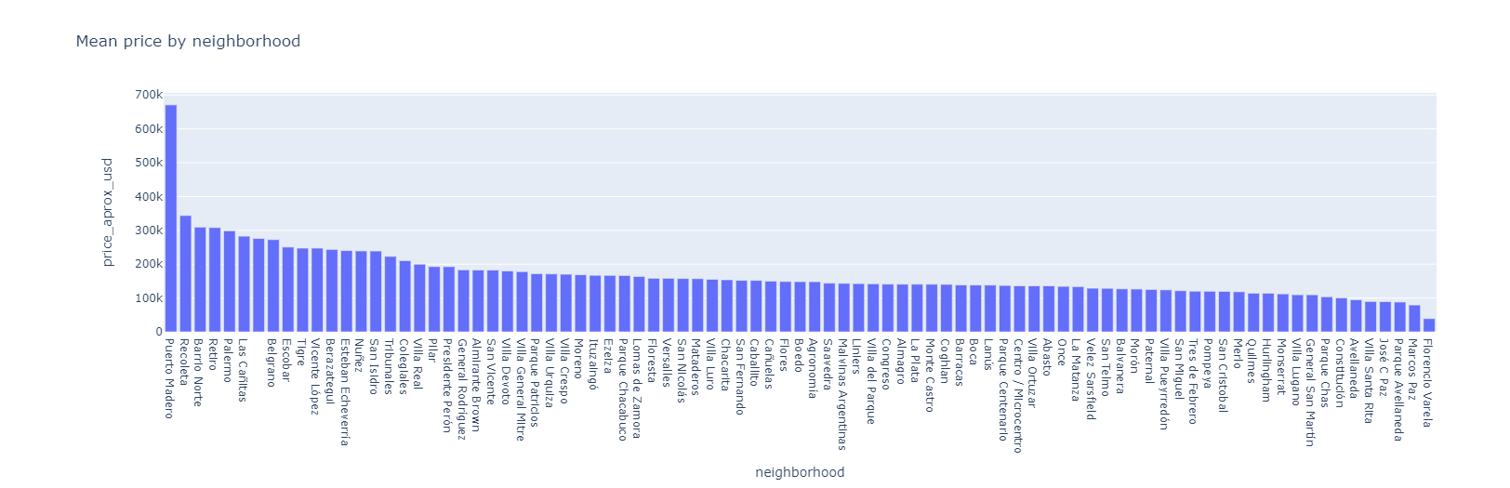
Is there a relationship between neighborhoods and property price?

Slide 10
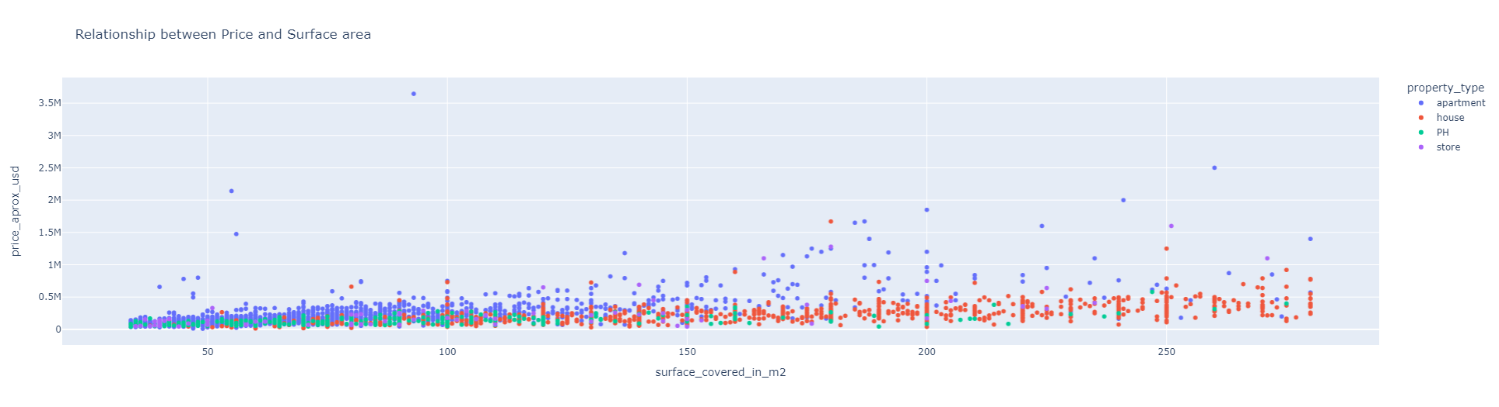
Is there a relationship between size of a property and price?
It can be noted from the above graph that most houses are bigger in size compared to the other property types.
It can also be noted that as the size of the property increases there is a slight increase in the property price.

Slide 11
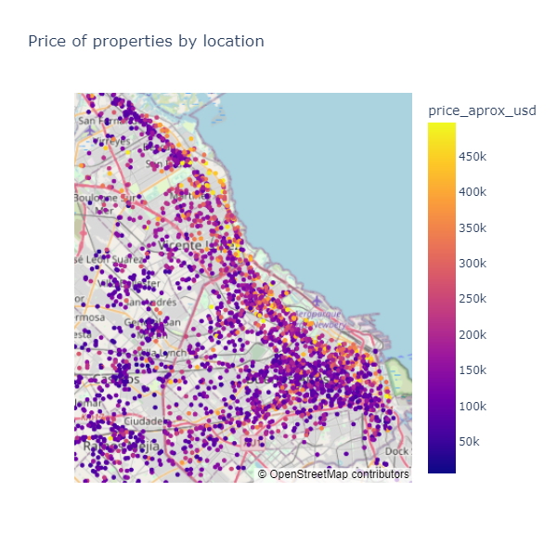
Is there a relationship between location and price?
It can clearly be observed that properties along the beach are more expensive that properties towards the mainland.

Slide 12
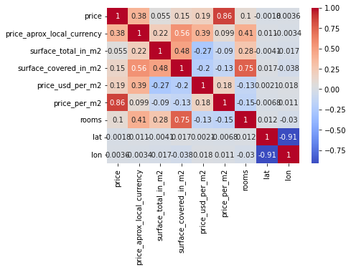
Feature selection and modeling
A heat map was used to plot the correlation between different variables and select features used to build the predictive model
Since we seek to predict price_aprox_usd we will drop all the column that contain price leakage for example; price, price_aprox_local_currency, price_per_m2, price_usd_per_m2.
Rooms and surface_total_in_m2 was dropped because it could cause multicollinearity.

Slide 13
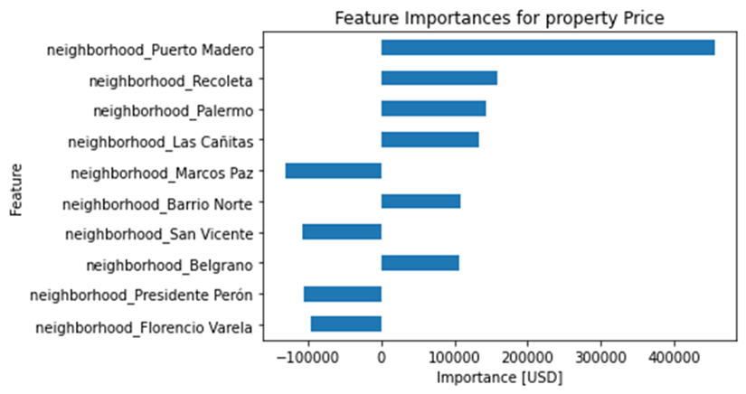
To build a predictive model, we used the features surface_covered_in_m2, lat, lon, and neighborhood to predict the target variable price_aprox_usd.
This data set was split into training and test sets, categorical values were encoded using OneHotEncoder and a model was built with the resulting data..
Evaluation of the dataset was done using data containing the features used.
The bar graph on the right reflects the 10 most common features that are most important when determining a property price. Neighborhoods is by far the most important of these, with some neighborhoods making a property very expensive and others having a negative impact on prices, making them very cheap.

Slide 14
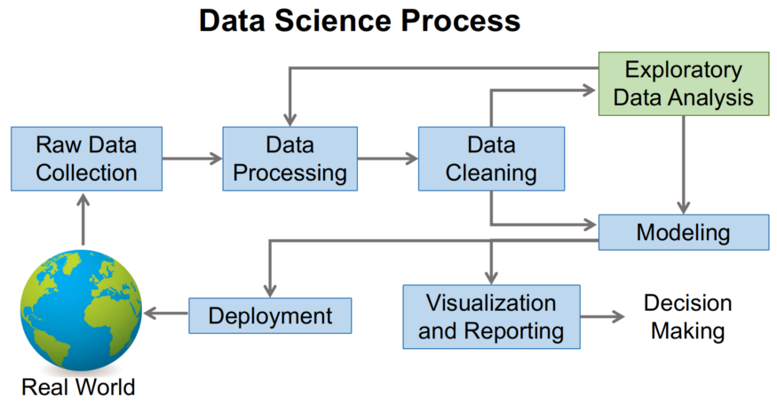
EDA Summary
EDA is a very important step in data analysis.
The EDA process can help identify obvious errors, find interesting relations among variables, detect outliers or anomalous events, and better understand patterns within the dataset.
Exploratory data analysis is the process of analyzing and better understanding a dataset before making any assumptions.

Slide 15
Recommendations
When looking for a property in Buenos Aires, one ought to consider the neighborhoods and the location and size of the property to determine the price of the property.

Slide 16
Thank You

